Slide 1

Infrastructure and configuration Azure tools

Slide 2
Lesson 01: Module overview

Slide 3
Module overview
Lesson 1: Module overview
Lesson 6: Desired State Configuration (DSC)
Lesson 2: Infrastructure as code and configuration management
Lesson 7: Azure Automation with DevOps
Lesson 3: Create Azure resources using ARM templates
Lesson 8: Additional Automation Tools
Lesson 4: Create Azure resources by using Azure CLI
Lesson 9: Lab
Lesson 5: Create Azure resources by using Azure PowerShell
Lesson 10: Module review and takeaways

Slide 4
Learning objectives
After completing this module, students will be able to:
Apply infrastructure and configuration as code principles
Deploy and manage infrastructure using Microsoft automation technologies such as ARM templates, PowerShell, and Azure CLI

Slide 5
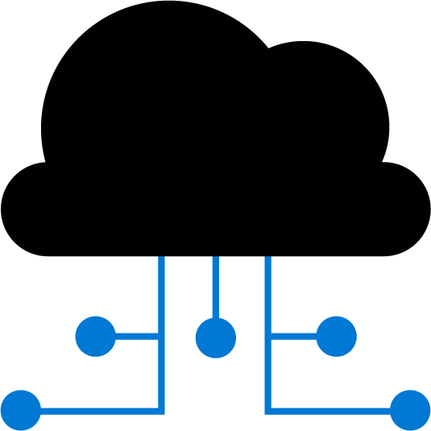
Lesson 02: Infrastructure as code and configuration management

Slide 6
Environment deployment
Manual deployment:
Snowflake servers
Deployment steps vary by environment
More verification steps and more elaborate manual processes
Increased documentation to account for differences
Deployment on weekends to allow time to recover from errors
Slower release cadence to minimize pain and long weekends
Infrastructure as code:
Consistent servers between environments
Environments created or scaled easily
Fully automate creation and updates of environments
Transition to immutable infrastructure
Use blue/green deployments
Treat servers as cattle, not pets
Notes:
Could highlight two items to ensure students understand the meaning:
Immutable means that the service is not updated. If a change is needed to an environment, a new one is deployed and the old one taken down.
blue/green deployments. This is a release methodology to minimize downtime, where two identical environments exist, one is live and the other is not. Updates are applied to the server that is not live, and when testing is verified and complete, it is switched to become the live environment and the previous live environment is no longer the live environment i.e. they are swapped. It can also be referred to as A/B deployment.
Common scenario for Infrastructure as Code: Server failure
Difficulty of reproducing steps for setting up a new machine from memory or disparate sources
Potential for human error when initializing machines
Severe implications if a machine crashes and must be immediately replaced
Solution: treat environments and infrastructure like code
Deployed from a single consistent definition
This is termed Infrastructure as Code
Maintain a consistent environment between development and production

Slide 7
Environment configuration
Manual configuration:
Configuration bugs difficult to Identify
Error prone
More verification steps and more elaborate manual processes
Increased documentation
Deployment on weekends to allow time to recover from errors
Slower release cadence to minimize requirement for long weekends
Configuration as code:
Bugs easily reproducible
Consistent configuration
Increase deployment cadence to reduce amount of incremental change
Treat environment and configuration as executable documentation
Notes:
Could discuss definitions and understanding of Configuration Management such as:
Automated management of configuration via scripts
Scripts define the configuration of an application, and the environment and infrastructure required to support it
Lighter-weight executable configurations
Enable the scripting and automation of environment configuration
Infrastructure as Code can describe both provisioning and configuration of environments
This model scales better across multiple servers than a manual deployment would

Slide 8
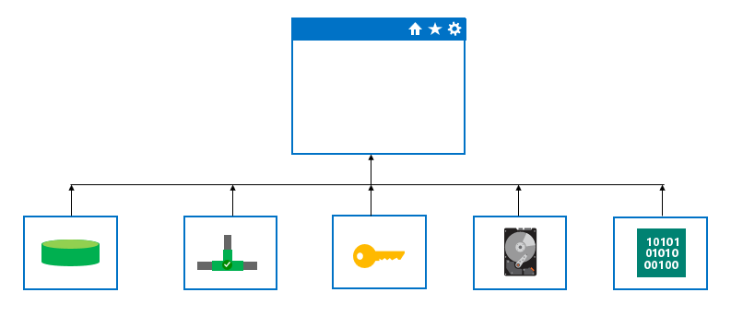
Modularization
Divide automation assets into logical parts:
Databases, networks, storage, security, OS, and other components
Benefits of modularization:
Reuse of components
Manage and maintain your code
Sub-divide work and responsibilities across teams
Troubleshooting
Extend and add to existing infrastructure definitions
Notes:
You can break up your automation assets into their own logical parts such as databases, networks, storage, security, operating systems and other components.

Slide 9
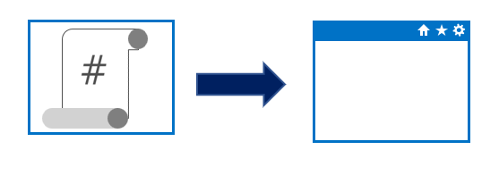
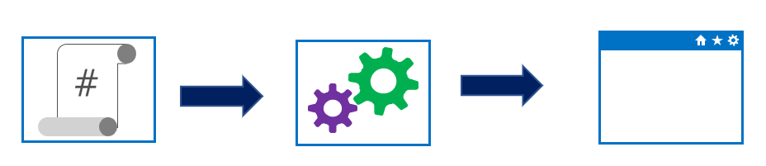
Imperative vs. declarative
Approaches to implementing infrastructure and configuration as code
Declarative:
Functional
Defines what the final state should be
Imperative:
Procedural
Defines the “how” for what the final state should be
Notes:
Could mention that Imperative can also be known or called as procedural. And Declarative can sometimes be referred to as functional.
Declarative abstracts away the methodology of how a state is achieved.
A declarative approach would generally be the preferred option where ease of use is the main goal. Azure Resource Manager template files are an example of a declarative automation approach.
An imperative approach may have some advantages where there are complex scenarios where changes in the environment take place relatively frequently, which need to be accounted for in your code.
There is no absolute on which is the best approach to take, and individual tools may be able to be used in either declarative or imperative forms. The best approach for you to take will depend on your particular needs

Slide 10
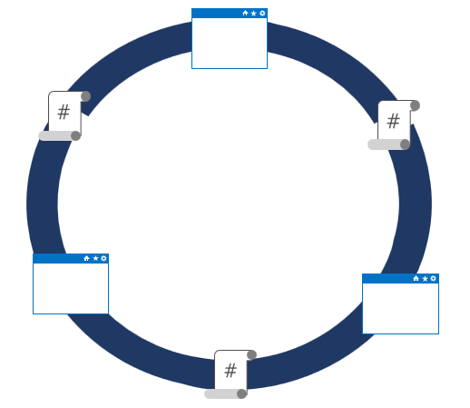
Idempotence
Idempotence – definition:
Mathematical term used in the context of infrastructure and configuration as code
Ability to apply one or more operations against a resource, resulting in the same outcome
To attain idempotence:
Automatically configure and reconfigure an existing set of resources, or
Discard existing resources and spin up a fresh environment
Notes:
Idempotence – mathematical term used in the context of infrastructure and configuration as code, referring to the ability to apply one or more operations against a resource, resulting in the same outcome.
For more information about idempotence in general and in the context of Azure, see - https://www.wintellect.com/idempotency-for-windows-azure-message-queues/

Slide 11
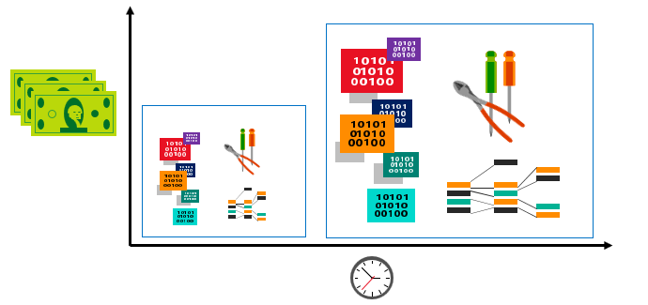
Technical debt
Technical debt:
Term to describe the future penalty incurred today by making easy or quick choices in software development practices
Over time, accrues in same way that monetary debt does
Common sources of technical debt:
Lack of coding style and standards
Lack of, or poor design of, unit test cases
Changes in project scope, such as deciding to localize and already release product
Making manual changes to resources.
Not writing self-documenting code
Taking shortcuts to meet deadlines
Notes:
✔️ Over time, technical debt must be paid back. Otherwise, the team's ability to fix issues, and to implement new features and enhancements will take longer and longer, and eventually become cost-prohibitive.
Consider the following as a discussion:
Question? Can Azure Resource Manager templates contain technical debt?
Answer: Yes. Azure resource Manage templates deploy and configure resources in Azure. Azure is a cloud-based platform and is continually changing and evolving. When deploying resources using templates, you frequently need to retrieve information about the resource providers and types. As a resource provider enables new features, it releases a new version of the REST API. As such components within your resource manager templates which rely on API versions to provision and configure resources may need periodic updating.
A solution to address the debt in Azure Resource Manager templates could be to validate API versions in your templates to ensure they are current and not deprecated, as part of your general work development work.
You could also mention that there are tools available to help define and manage technical debt, such as SonarQube

Slide 12
Configuration drift
Configuration drift:
Process whereby a set of resources change their state over time
Can occur from changes made by people, processes, or programs
Potential security risks introduced by configuration drift: Open ports that should have been closed
Inconsistent patching across environments
Software that doesn’t meet compliance requirements
Solutions that can help:
Windows PowerShell Desired State Configuration
Azure Policy
Many non-Microsoft solutions integrated with Azure

Slide 13
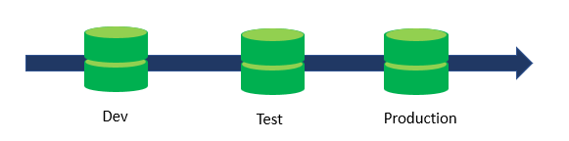
Database as code
The database can be treated as code for higher efficiency and fewer delays:
Can be versioned like applications
Bugs easily reproduced and configuration remains consistent
Benefits of database as code:
Make changes in smaller increments
Configuration scripts can be treated as executables
Verify schema changes between production and development
Auditability

Slide 14

Lesson 03: Create azure resources using Azure CLI

Slide 15
What is Azure CLI?
Command-line program to connect to Azure
Execute administrative commands on Azure resources through a terminal, command-line prompt, or script, instead of a web browser:
For example, to restart a VM use the command:
az vm restart -g MyResourceGroup -n MyVm
Can be installed on Linux, Mac, or Windows computers
Can be use interactively or scripted:
Interactive: Issue commands directly at the shell prompt
Scripted: Assemble the CLI commands into a shell script and then execute the script
Notes:
The Azure CLI is a command-line program to connect to Azure and execute administrative commands on Azure resources. It runs on Linux, macOS, and Windows and allows administrators and developers to execute their commands through a terminal or command-line prompt (or script!) instead of a web browser.
Mention the cross-platform command-line tools support for managing Azure resources, as well as the ability to access the CLI from the Cloud Shell.

Slide 16
Demonstration installing Azure CLI
Method for Installing Azure CLI depends on the platform
Linux:
For Ubuntu Linux install the Azure CLI using the Advanced Packaging Tool (apt) and the Bash command line
Package managers are dependent on the Linux version and distribution
MacOS:
Use the Homebrew package manager
Windows:
Install the Azure CLI on Windows using the MSI installer or using Chocolatey package manager for windows
Notes:
Don’t spend too much time on this slide. The method you use for installing the Azure CLI depends on the operating system of your computer. Choose the steps listed below for your operating system.
Point out that the actual package manager commands used with the azure CLI on Linux will depend on the version and distribution of Linux. Consult the documentation.
You run the Azure CLI by opening a bash shell (Linux and macOS), or from the command prompt or PowerShell (Windows).
Point out the differences in the examples in the content with which each OS runs commands to verify the install of the Azure CLI.
Details of the installation per platform are available on the page https://docs.microsoft.com/en-us/cli/azure/install-azure-cli?view=azure-cli-latest

Slide 17
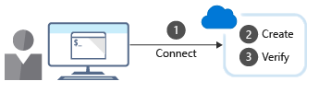
Working with Azure CLI
Commands in the CLI are structured in groups and subgroups:
Example: Storage group contains subgroups like account, blob, storage, and queue
Use az find to find commands you need az find -q blob
Use the - -help argument to get more detail about the command az storage blob --help
Creating a new Azure resource typically involves the following process:
Notes:
Discuss how CLI is organized into groups and sub groups.
Explain how to use the find and - -help arguments to locate commands and their syntax. Use the examples provided in the content to talk about creating a resource group using group create, and viewing resource details using the list sub-command.
Point out the difference between using the shell and PowerShell when running CLI commands in scripts.

Slide 18
Extensions
With extensions, you gain access to experimental and pre-release commands along with the ability to write your own Azure CLI interfaces
Find Azure CLI extensions
az extension list-available --output table
Install or uninstall Azure CLI extensions
az extension add --name <extension-name>
az extension remove --name <extension-name>
Run VM extensions using Azure CLI
az vm extension <sub-command > <parameter>

Slide 19
LAB
Notes:
You can choose to play the video or present a similar demo yourself.

Slide 20
Lesson 04: Create Azure resources using ARM templates

Slide 21
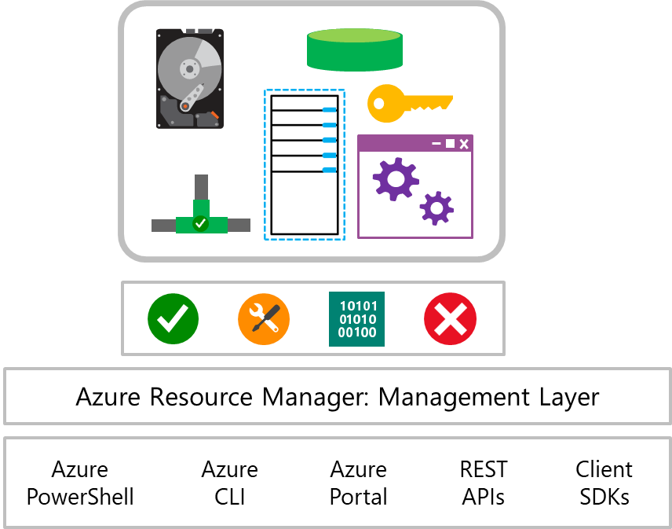
What is Azure resource manager?
Azure Resource Manager is a management layer in which a resource group and all the resources within it are created, configured, managed, and deleted
Notes:
Azure Resource Manager provides a consistent management layer that allows you automate deployment and configuration of resources, using different automation and scripting tools such as Microsoft Azure PowerShell, Azure Command-Line Interface (Azure CLI), Microsoft Azure portal, REST API, and client SDKs.

Slide 22
Azure resource manager templates
Azure Resource Manager Templates:
Precisely define all the Resource Manager resources in a deployment
Are written in JavaScript Object Notation (JSON) format
Are Declarative in nature
Allow you to consistently deploy a solution with confidence that resources are deployed in a consistent state
Allow you to reuse an existing template across different environments such as dev, test and production
Allow you to re-use existing templates and customize them to your specific needs
Notes:
.

Slide 23
Template components
JSON stores data stored as an object in text. A JSON document is a collection of key-value pairs
JSON files can contain the following sections:
Parameters
Variables
Functions
Resources
Outputs
Notes:
Go over the examples provided in the student content of each different section in an ARM template.
JSON allows us to express data stored as an object (such as a virtual machine) in text. A JSON document is essentially a collection of key-value pairs.

Slide 24
What’s in a Resource Manager Template?
https://schema.management.azure.com/schemas/2019-04-01/deploymentTemplate.json
{
"$schema": "https://schema.management.azure.com/schemas/2019-04-01/deploymentTemplate.json#",
"contentVersion": "",
"parameters": { },
"variables": { },
"functions": [ ],
"resources": [ ],
"outputs": { }
}
ARM Template Reference
Resource Explorer
ARM Documentation

Slide 25
What’s in a Resource Manager Template?
https://schema.management.azure.com/schemas/2019-04-01/deploymentTemplate.json
{
"$schema": "https://schema.management.azure.com/schemas/2019-04-01/deploymentTemplate.json#"
}
For subscription deployments, use:
https://schema.management.azure.com/schemas/2018-05-01/subscriptionDeploymentTemplate.json#
For management group deployments, use:
https://schema.management.azure.com/schemas/2019-08-01/managementGroupDeploymentTemplate.json#
For tenant deployments, use:
https://schema.management.azure.com/schemas/2019-08-01/tenantDeploymentTemplate.json#

Slide 26
What’s in a Resource Manager Template?
"parameters": {
"adminUsername": {
"type": "string",
"metadata": {
"description": "Username for the Virtual Machine."
}
},
"adminPassword": {
"type": "securestring",
"metadata": {
"description": "Password for the Virtual Machine."
}
}
}

Slide 27
What’s in a Resource Manager Template?
"variables": {
"nicName": "myVMNic",
"addressPrefix": "10.0.0.0/16",
"subnetName": "Subnet",
"subnetPrefix": "10.0.0.0/24",
"publicIPAddressName": "myPublicIP",
"virtualNetworkName": "MyVNET"
}

Slide 28
What’s in a Resource Manager Template?
"functions": [
{
"namespace": "contoso",
"members": {
"uniqueName": {
"parameters": [
{
"name": "namePrefix",
"type": "string"
}
],
"output": {
"type": "string",
"value": "[concat(toLower(parameters('namePrefix')), uniqueString(resourceGroup().id))]"
}
}
}}],

Slide 29
What’s in a Resource Manager Template?
"resources": [
{
"type": "Microsoft.Network/publicIPAddresses",
"name": "[variables('publicIPAddressName')]",
"location": "[parameters('location')]",
"apiVersion": "2018-08-01",
"properties": {
"publicIPAllocationMethod": "Dynamic",
"dnsSettings": {
"domainNameLabel": "[parameters('dnsLabelPrefix')]"
}
}
}
],

Slide 30
What’s in a Resource Manager Template?
"outputs": {
"hostname": {
"type": "string",
"value": "[reference(variables('publicIPAddressName')).dnsSettings.fqdn]"
}
}

Slide 31
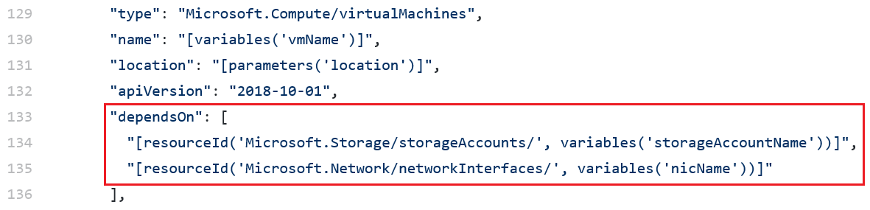
Manage dependencies
Some resources will depend on other resources before you can deploy them
Define this relationship by marking the dependency with the dependsOn element
Notes:
You can define this relationship by marking one resource as dependent on the other resource. You define a dependency with the dependsOn element. You can also use the reference function.
Mention troubleshooting circular reference problems, by either removing a dependency or moving a dependency into a child resource that is deployed after the resources that contained the problem dependency.

Slide 32
Deployoment modes
Validate
This option compiles the templates, validates the deployment, ensures the template is functional (for example, no circular dependencies), and the syntax is correct.
Incremental (default)
This option only deploys whatever is defined in the template. It does not remove or modify any resources that are not defined in the template.
Complete:
Resource Manager deletes resources that exist in the resource group, but aren't specified in the template.
Notes:
Also discuss using nested templates with the template property and syntax. You can refer students to the examples in the content.
Mention that while there are three deployment options available that incremental mode is the default mode and it doesn’t remove or modify any resources not defined in the template.
Mention that it’s a best practice to use one resource group per deployment.
Also discuss securing an external template by adding the template to a private storage account and providing a SAS token to enable access during deployment.

Slide 33
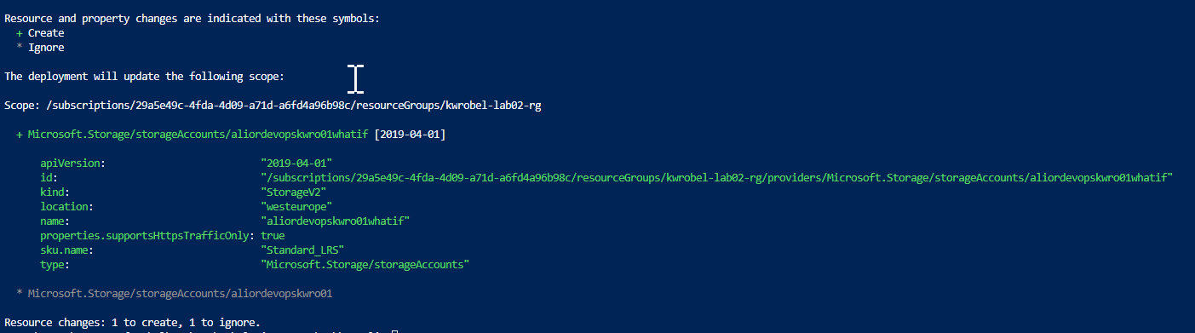
What-If
Preview changes that will happen
Notes:
Also discuss using nested templates with the template property and syntax. You can refer students to the examples in the content.
Mention that while there are three deployment options available that incremental mode is the default mode and it doesn’t remove or modify any resources not defined in the template.
Mention that it’s a best practice to use one resource group per deployment.
Also discuss securing an external template by adding the template to a private storage account and providing a SAS token to enable access during deployment.

Slide 34
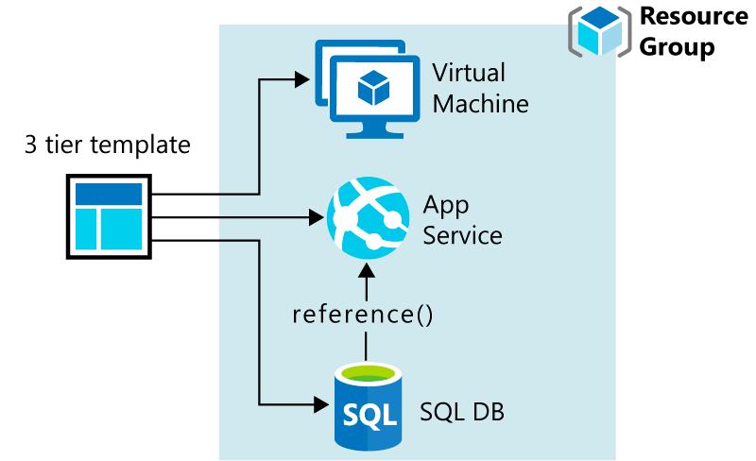
Overview of Resource Manager Templates (1 of 3)
What are Resource Manager templates?
Template design

Slide 35
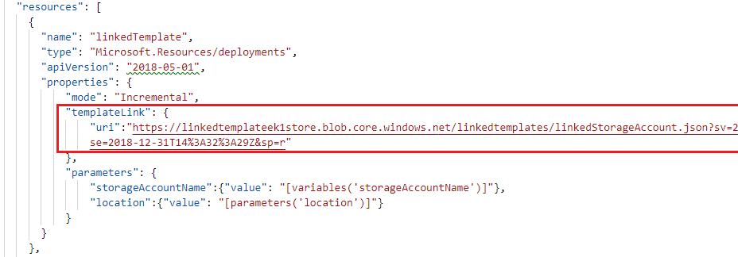
Modularize templates – Linked templates
Best practice: Modularize templates into individual components:
Use linked templates to break the solution into individual pieces
Reuse those elements across different deployments
Use SAS token to access your private templates
Notes:
Also discuss using nested templates with the template property and syntax. You can refer students to the examples in the content.
Mention that while there are three deployment options available that incremental mode is the default mode and it doesn’t remove or modify any resources not defined in the template.
Mention that it’s a best practice to use one resource group per deployment.
Also discuss securing an external template by adding the template to a private storage account and providing a SAS token to enable access during deployment.

Slide 36
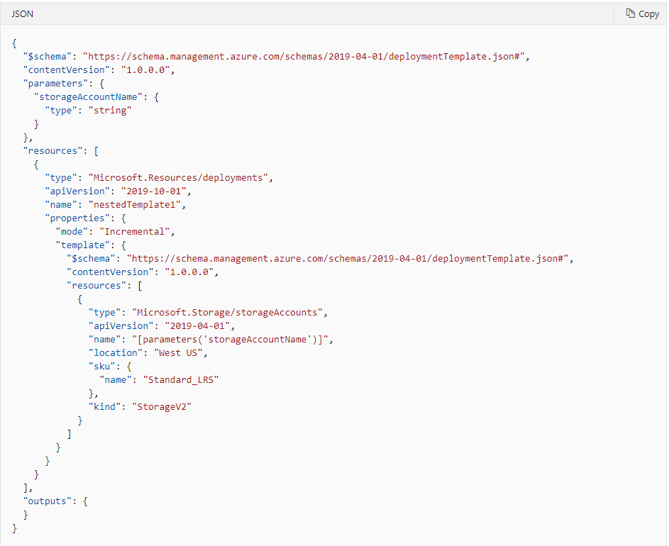
Modularize templates – Nested Templates
Use Nested templates when your solution is simple, but you need to achieve something advanced, like deployment to a different resource group or using different deployment scopes
For nested templates, you cannot use parameters or variables that are defined within the nested template itself. You can only use parameters and variables from the main template.
Notes:
Also discuss using nested templates with the template property and syntax. You can refer students to the examples in the content.
Mention that while there are three deployment options available that incremental mode is the default mode and it doesn’t remove or modify any resources not defined in the template.
Mention that it’s a best practice to use one resource group per deployment.
Also discuss securing an external template by adding the template to a private storage account and providing a SAS token to enable access during deployment.

Slide 37
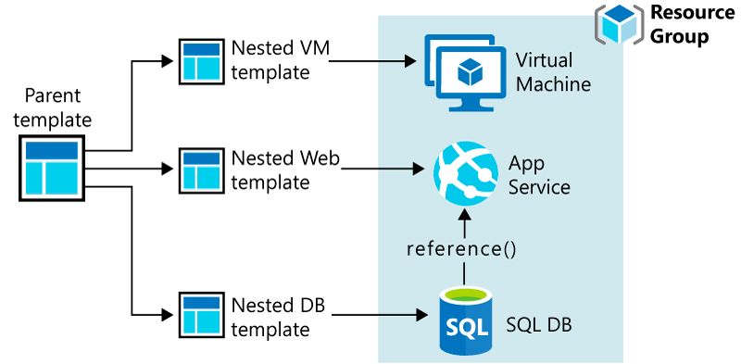
Overview of Resource Manager Templates (Nested Templates)

Slide 38
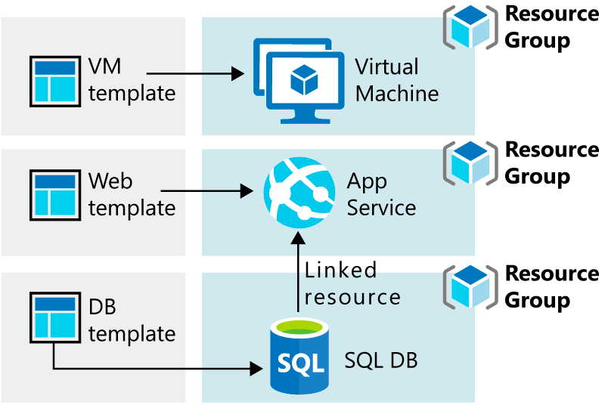
Overview of Resource Manager Templates (Linked Templates)

Slide 39
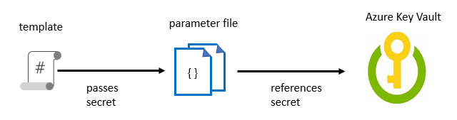
Managing secrets in templates
When passing a secure value (e.g. a password) as a parameter during deployment:
Create a key vault and secret using Azure CLI or PowerShell
Set the key vault property enabled For Template Deployment to true
Reference the key pair in the parameter file, not the template
Enable access to the secret. Owner and Contributor roles grant access
Deploy the template and pass in the parameter file
Notes:
For more information about how to use Azure Key Vault to pass secure parameter value during deployment, see: https://docs.microsoft.com/en-us/azure/azure-resource-manager/resource-manager-keyvault-parameter
There also are details available on this page on how to reference a secret with a dynamic ID.
Discuss the example in the student content where a template is used to deploy a SQL database with an admin password. Outline the process of creating the key vault and secret and enabling access to the secret via permissions. Point out that the key vault ID is referenced in the parameter file, not the template, with the actual value never being exposed.
Note: we have not yet defined Azure CLI in the course, so you may need to tell students that it is a command line scripting interface for deployment and configuration of resources in Azure.

Slide 40
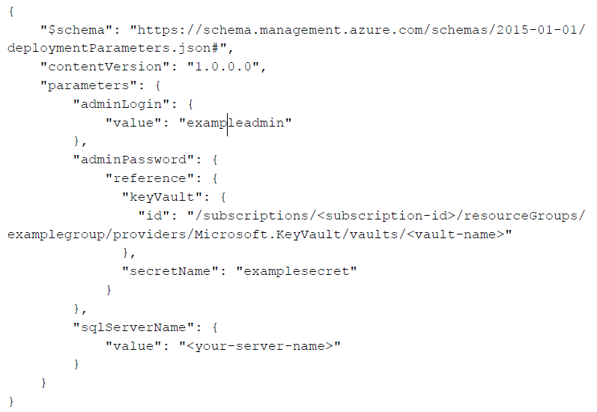
Managing secrets in templates
Notes:
For more information about how to use Azure Key Vault to pass secure parameter value during deployment, see: https://docs.microsoft.com/en-us/azure/azure-resource-manager/resource-manager-keyvault-parameter
There also are details available on this page on how to reference a secret with a dynamic ID.
Discuss the example in the student content where a template is used to deploy a SQL database with an admin password. Outline the process of creating the key vault and secret and enabling access to the secret via permissions. Point out that the key vault ID is referenced in the parameter file, not the template, with the actual value never being exposed.
Note: we have not yet defined Azure CLI in the course, so you may need to tell students that it is a command line scripting interface for deployment and configuration of resources in Azure.

Slide 41
Template extensions
Use the Custom Script Extension (CSE) to download and run scripts on your Azure VMs:
Store scripts in Azure storage or in a public repository, such as GitHub
Run manually or as part of an automated deployment
Implementing a Custom Script Extension:
Start with an Azure QuickStart template that does most of what you need and adapt it
Consult the reference documentation for the required properties
Remove parameters not required and add any additional parameters still needed
Specify dependent resources
Notes:
The Custom Script Extension (CSE) is an easy way to download and run scripts on your Azure VMs. It's just one of the many ways you can configure a VM, during its deployment or once it's up and running.
Discuss the example in the student content where a CSE is defined and added to a Resource Manager template. The resource uses the Custom Script Extension to download a PowerShell script from GitHub and then executes that script on a VM. The script enables the IIS-WebServerRole feature and configures a basic home page.
Encourage students to use the Azure Quickstart templates as a starting point and refer to the resource documentation for specific information such as required properties, which can be found below the schema definitions on the resource reference page. Depending on what you are looking to do, there may be some additional properties that get added to the Custom Script Extension.
You’ve already introduced the dependsOn property when you covered managing dependencies earlier, so emphasize this in the example in determining the correct order to apply resources. Walk through the completed syntax for the template resource, after having added the dependsOn property.

Slide 42
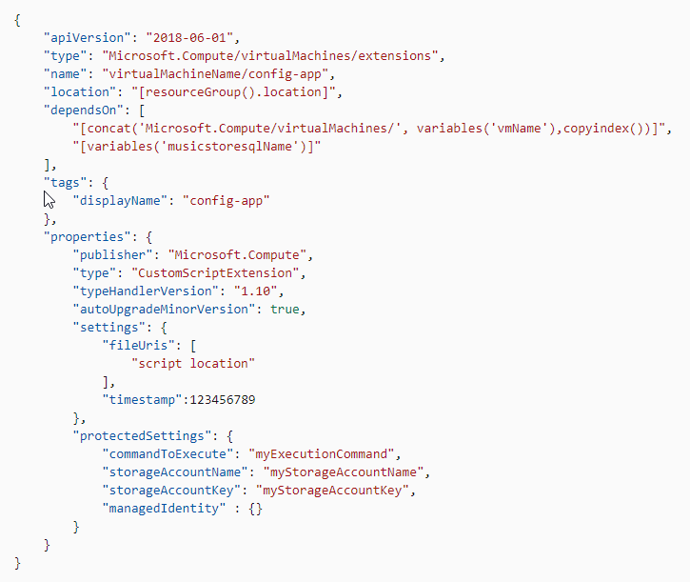
Custom script extension ARM template
Notes:
The Custom Script Extension (CSE) is an easy way to download and run scripts on your Azure VMs. It's just one of the many ways you can configure a VM, during its deployment or once it's up and running.
Discuss the example in the student content where a CSE is defined and added to a Resource Manager template. The resource uses the Custom Script Extension to download a PowerShell script from GitHub and then executes that script on a VM. The script enables the IIS-WebServerRole feature and configures a basic home page.
Encourage students to use the Azure Quickstart templates as a starting point and refer to the resource documentation for specific information such as required properties, which can be found below the schema definitions on the resource reference page. Depending on what you are looking to do, there may be some additional properties that get added to the Custom Script Extension.
You’ve already introduced the dependsOn property when you covered managing dependencies earlier, so emphasize this in the example in determining the correct order to apply resources. Walk through the completed syntax for the template resource, after having added the dependsOn property.

Slide 43
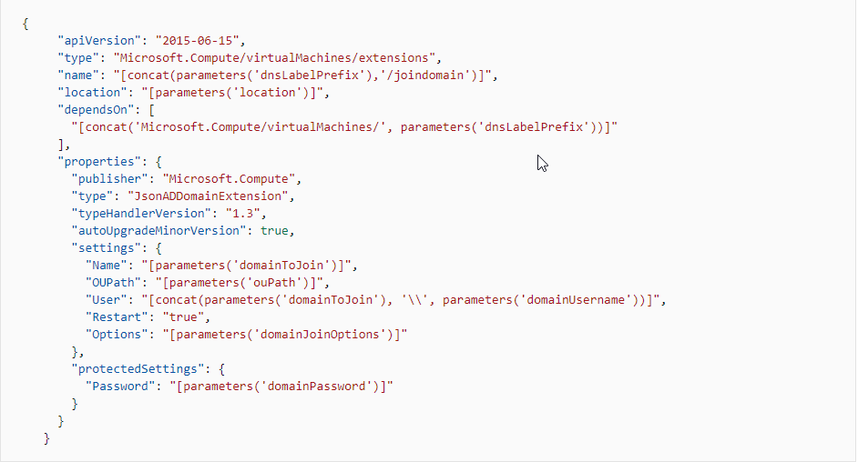
Domain join extension
Notes:
The Custom Script Extension (CSE) is an easy way to download and run scripts on your Azure VMs. It's just one of the many ways you can configure a VM, during its deployment or once it's up and running.
Discuss the example in the student content where a CSE is defined and added to a Resource Manager template. The resource uses the Custom Script Extension to download a PowerShell script from GitHub and then executes that script on a VM. The script enables the IIS-WebServerRole feature and configures a basic home page.
Encourage students to use the Azure Quickstart templates as a starting point and refer to the resource documentation for specific information such as required properties, which can be found below the schema definitions on the resource reference page. Depending on what you are looking to do, there may be some additional properties that get added to the Custom Script Extension.
You’ve already introduced the dependsOn property when you covered managing dependencies earlier, so emphasize this in the example in determining the correct order to apply resources. Walk through the completed syntax for the template resource, after having added the dependsOn property.

Slide 44
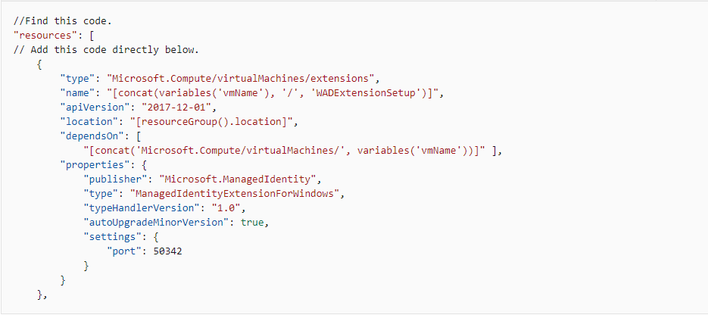
Azure Monitor extension
Notes:
The Custom Script Extension (CSE) is an easy way to download and run scripts on your Azure VMs. It's just one of the many ways you can configure a VM, during its deployment or once it's up and running.
Discuss the example in the student content where a CSE is defined and added to a Resource Manager template. The resource uses the Custom Script Extension to download a PowerShell script from GitHub and then executes that script on a VM. The script enables the IIS-WebServerRole feature and configures a basic home page.
Encourage students to use the Azure Quickstart templates as a starting point and refer to the resource documentation for specific information such as required properties, which can be found below the schema definitions on the resource reference page. Depending on what you are looking to do, there may be some additional properties that get added to the Custom Script Extension.
You’ve already introduced the dependsOn property when you covered managing dependencies earlier, so emphasize this in the example in determining the correct order to apply resources. Walk through the completed syntax for the template resource, after having added the dependsOn property.

Slide 45
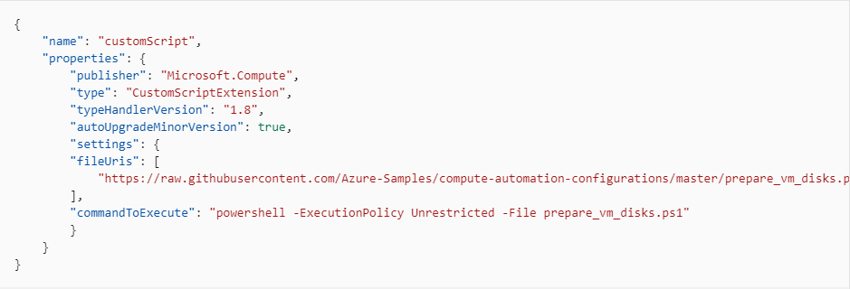
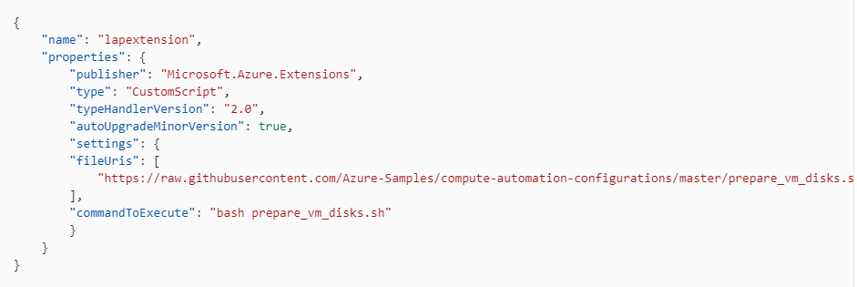
Prepare data disks extension
Notes:
The Custom Script Extension (CSE) is an easy way to download and run scripts on your Azure VMs. It's just one of the many ways you can configure a VM, during its deployment or once it's up and running.
Discuss the example in the student content where a CSE is defined and added to a Resource Manager template. The resource uses the Custom Script Extension to download a PowerShell script from GitHub and then executes that script on a VM. The script enables the IIS-WebServerRole feature and configures a basic home page.
Encourage students to use the Azure Quickstart templates as a starting point and refer to the resource documentation for specific information such as required properties, which can be found below the schema definitions on the resource reference page. Depending on what you are looking to do, there may be some additional properties that get added to the Custom Script Extension.
You’ve already introduced the dependsOn property when you covered managing dependencies earlier, so emphasize this in the example in determining the correct order to apply resources. Walk through the completed syntax for the template resource, after having added the dependsOn property.

Slide 46
Subscription-level resources
Some services should be deployed across a subscription and not just at the individual resource group level. For example:
Azure Policy
Role-based Access Control
When deploying to your subscription:
Location is required for the deployment
If no name is specified, the name of the template is used by default
Using template functions with subscription level deployments:
Use the resourceId() function to get the resource ID for resources used at subscription level reference() and list() functions are supported, but resourceGroup() is not
Notes:
Typically, you deploy resources to a resource group in your Azure subscription. However, you can use the subscription-level deployments to create resource groups and resources that apply across your subscription
You can view more specific details about subscription level deployments at https://docs.microsoft.com/en-us/azure/azure-resource-manager/deploy-to-subscription?view=sql-server-2017.

Slide 47
Why use ARM templates?
Make deployments faster and more repeatable
Improve consistency by providing a common language
Enable you to deploy multiple resources in the correct order by mapping out resource dependencies
Reduce manual, error-prone tasks
Templates can be linked together to provide a modular solution
Notes:
Can discuss some of the benefits of using ARM templates when deploying and configuring resources in Azure.

Slide 48
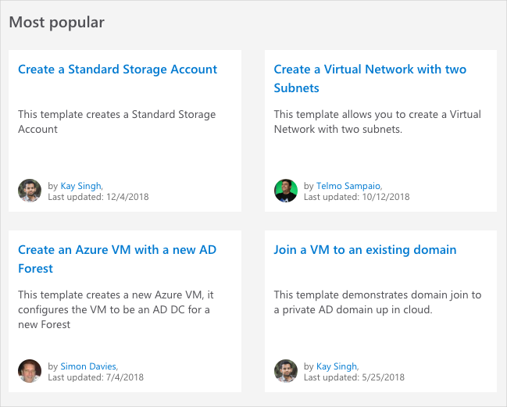
Azure Quickstart Templates (1 of 5)
Browse to Quickstart template gallery

Slide 49
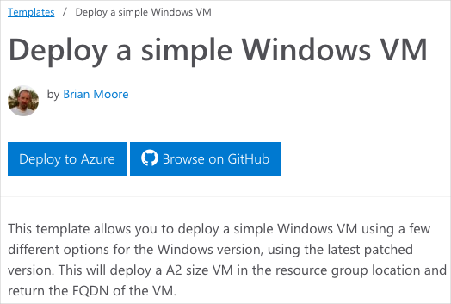
Azure Quickstart Templates (2 of 5)
Select a template

Slide 50
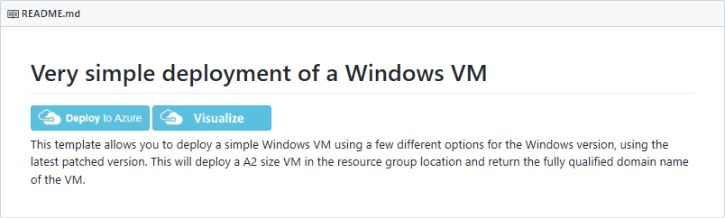
Azure Quickstart Templates (3 of 5)
Resource Manager templates provided by the Azure community
QuickStart templates are accessible via https://azure.microsoft.com/en-us/resources/templates/ or https://github.com/Azure/azure-quickstart-templates
Notes:
Resource Manager templates that are provided by the Azure community. In most cases, you will want to use these templates as a starting point and customize to your own specific needs, as opposed to creating from scratch.
✔️ Quickstart templates are accessible via https://azure.microsoft.com/en-us/resources/templates/ or https://github.com/Azure/azure-quickstart-templates.

Slide 51
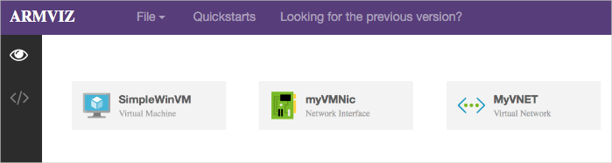
Azure Quickstart templates (4 of 5)
Visualize the template

Slide 52
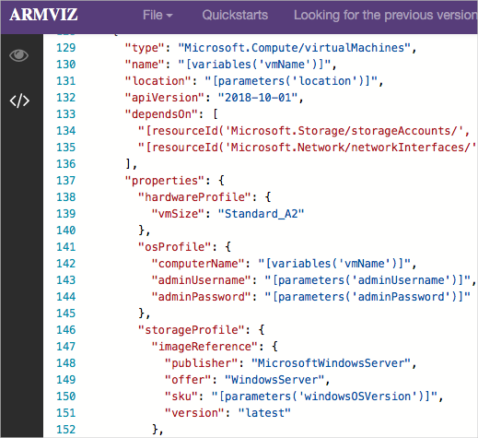
Azure Quickstart templates (5 of 5)
Review JSON that defines the Azure resource

Slide 53
LAB
Notes:
You can choose to play the video or present a similar demo yourself.

Slide 54
Lesson 05: Create Azure resources by using Azure PowerShell

Slide 55
PowerShell components
PowerShell provides commands known as cmdlets:
Intended to be small, single purpose functions
Performs tasks ranging from OS administration, working with ftp, file access, and much more
Cmdlets follow a verb-noun naming convention: Get-Process
Use Get-Help to display the help file for any cmdlet
Get-Help Get-ChildItem -detailed
Cmdlets are packaged into Modules that you can add to your PowerShell installation
Get a list of all currently loaded modules by typing Get-Module
Notes:
Give a brief overview of what PowerShell is if needed i.e. a command-line shell that includes an interactive prompt and a scripting environment that can be used independently or in combination for automating configuration and management tasks, and that allow you to do any type of bulk operation
PowerShell on Windows (default in Windows environments)
PowerShell Core (cross platform version: Windows, Linux, or macOS)

Slide 56
What is Azure PowerShell?
Module added to Windows PowerShell or PowerShell Core:
Connect to your Azure subscription and manage resources
Adds the Azure-specific commands
Example: The NewAzVm command
New-AzVm‘
ResourceGroupName “CrmTesting ResourceGroup” ‘
Name “CRMUnitTests” ‘
Image “UbuntuLTS”
Azure PowerShell available either locally or via the Cloud Shell
Can be use in interactive or scripting mode

Slide 57
Installing Azure powerShell on different platforms
Two components allow PowerShell to configure and manage Azure resources, regardless of platform:
Base PowerShell product (Windows PowerShell or PowerShell Core)
Azure PowerShell module
Linux and macOS:
Install PowerShell Core version on Linux and macOS
Linux package manager depends on Linux distribution chosen
Like Azure CLI, macOS system uses Homebrew package manager
Windows:
PowerShell is included in Windows Server and client by default
Can check the installed version, with the below command
$PSVersionTable.PSVersion
Notes:
Note: PowerShell is included with Windows (but might have an update available which you should generally take). You will need to install PowerShell Core on Linux and macOS.

Slide 58
Demonstration install Azure PowerShell
Install the Az module:
Shortened Az cmdlet prefix replaces the –AzureRm format
Modules available from the PowerShell gallery, and require an elevated PowerShell prompt to install
Install-Module -Name Az -AllowClobber
Relies on the NuGet package manager to retrieve components
By default, PowerShell Gallery isn't configured as a trusted repository for PowerShellGet
Set-PSRepository -Name "myInternalSource“ -InstallationPolicy Trusted
Notes:
NOTE: You may have seen or used Azure PowerShell commands that used a -AzureRM format. In Dec 2018 Microsoft released to general availability the replacement of the AzureRM module with the Az module. This new module has several features, notably a shortened cmdlet noun prefix of -Az instead of -AzureRM. The Az module ships with backwards compatibility with the AzureRM module so the -AzureRM cmdlet format will work, but you should transition to the Az module and use the -Az commands going forward.
Discuss the PowerShell gallery, where students can access it and how to work with it. Emphasize that the PowerShell gallery provides a great central repository for sharing and acquiring PowerShell code including PowerShell modules, scripts, and DSC resources.
Mention that you may be prompted to upgrade to the latest version of NuGet depending on the version you have (if you already have an existing version installed).
Also point out the Set-PSRepository example on the slide as a way to set the installation policy for the myInternalSource repository to Trusted, so that you won’t be prompted before installing modules from that source.

Slide 59
Demonstration run templates with PowerShell
1
Connect to your subscription and authenticate
Connect-AzAccount
Create a new service or resource, for example a resource group
New-AzResourceGroup -Name <resource group name> -Location <your nearest datacenter>
2
Verify the deployment of the sample template
Get-AzVM -Name <your VM name> -resourcegroupname <your resource group name>
3
Notes:
Point out that when creating resources with ARM templates, the process is similar to working with Azure CLI.
Walk through the details of the deployment script in the template JSON file (https://raw.githubusercontent.com/Microsoft/PartsUnlimited/master/Labfiles/AZ-400T05_Implementing_Application_Infrastructure/M01/azuredeploy.json).
Remind students that the resource group name must have a name and a location, that the name must be unique within the subscription, and that the location determines where metadata is stored.
You can also create a script using parameter values for things like username, password, and dnslabelprefix, allowing you to run the template without manual input.
The sample template is a good example of using PowerShell in interactive mode, in this case it’s easier than writing a complete script that you only execute once.

Slide 60
VM extensions with PowerShell
Include Azure VM extensions with ARM templates for making configuration changes on already deployed VMs
To see a list of individual extensions:
Get-Command Set-*Extension* -Module Az.Compute
Set-AzureRmVMCustomScriptExtension ` - ResourceGroupName "ResourceGroup11" ` - Location “Central US" -VMName "VirtualMachine07“` - Name "ContosoTest" –TypeHandlerVersion "1.1" ` - StorageAccountName "Contoso" `
- StorageAccountKey <StorageKey> `
- FileName "ContosoScript.exe"
- ContainerName "Scripts"
Example of a Custom Script Extension:
Notes:
Point out that the wild characters in the command are intentional and its use will return all cmdlets that contain the word “extension”, so they can all be viewed.
Also, point students to the Azure documentation from where the sample Custom Script Extension is taken.
Set-AzureRmVMCustomScriptExtension
https://docs.microsoft.com/en-us/powershell/module/azurerm.compute/set-azurermvmcustomscriptextension?view=azurermps-6.13.0#examples

Slide 61

Lesson 06: Desired State Configuration (DSC)

Slide 62
Desired state configuration (DSC)
Ensures that an environment is maintained in a state that you specify (defined state), to eliminate configuration drift, and no deviation from that defined state
Components:
Configurations: Idempotent declarative PowerShell scripts
Resources: PowerShell scripts compiled into .mof format files to ensure state
Local Configuration Manager (LCM): Client engine to ensure configuration
Methods of Implementing DSC:
Push mode: A user actively pushed put a configuration to environments
Pull mode: Clients get state from remote pull service automatically. Remote service is provided by a pull server, which acts as a central control and manager for the configurations
Notes:
not deviate from that defined state

Slide 63
Azure automation state configuration (DSC)
A cloud-based implementation of PowerShell DSC, available as part of Azure Automation
Characteristics:
Built-in pull server: Built-in pull server in Azure Automation eliminates the need to set up and maintain your own pull server
Management of all DSC artifacts: Manage all DSC configurations, resources, and target nodes in single instance in the Azure portal or PowerShell
Ability to Import Reporting Data directly into Azure Log Analytics: Can send this data to your Log Analytics workspace
Notes:
Could discuss how the general process for how Azure Automation State configuration works, which is as follows:
Create a PowerShell script with the configuration element
Upload the script to Azure Automation and compile the script into a MOF file. The file is transferred to the DSC pull server, which is provided as part of the Azure Automation service. (See Managed Object Format (MOF) file at https://docs.microsoft.com/en-us/windows/desktop/WmiSdk/managed-object-format--mof- for more information on MOF files.)
Define the nodes that will use the configuration, and then apply the configuration.

Slide 64
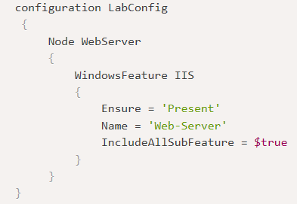
DSC configuration file
Configurations are Windows PowerShell scripts that define a special type of function.
Config File Elements:
Configuration block: Name of the configuration
Node block: Define nodes being configured i.e. VMs and servers
Resource blocks: Defines the actual configuration state for the nodes
Notes:
Configuration block. The Configuration block is the outermost script block. In this case, the name of the configuration is LabConfig. Notice the curly brackets to define the block.
Node block. There can be one or more Node blocks. These define the nodes (computers and VMs) that you are configuring. In this example, the node targets a computer called WebServer. You could also call it localhost and use it locally on any server.
Resource blocks. There can be one or more resource blocks. This is where the configuration sets the properties for the resources. In this case, there is one resource block called WindowsFeature. Notice the parameters that are defined. (You can read more about resource blocks at https://docs.microsoft.com/en-us/powershell/dsc/resources/resources)
Within a Configuration block, you can do almost anything that you normally could in a PowerShell function. You can also create the configuration in any editor, such as PowerShell ISE, and then save the file as a PowerShell script with a .ps1 file type extension.

Slide 65
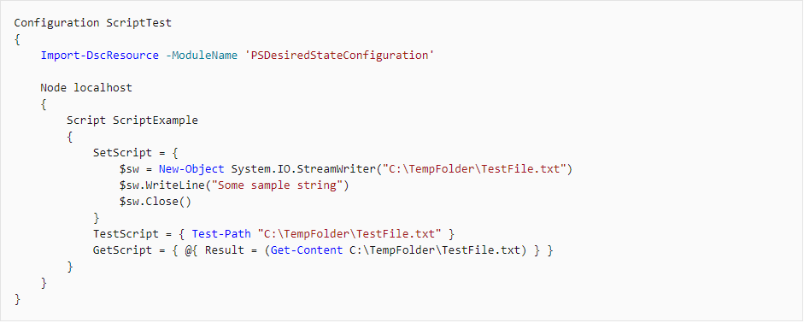
DSC configuration file
Custom DSC script
Notes:
Configuration block. The Configuration block is the outermost script block. In this case, the name of the configuration is LabConfig. Notice the curly brackets to define the block.
Node block. There can be one or more Node blocks. These define the nodes (computers and VMs) that you are configuring. In this example, the node targets a computer called WebServer. You could also call it localhost and use it locally on any server.
Resource blocks. There can be one or more resource blocks. This is where the configuration sets the properties for the resources. In this case, there is one resource block called WindowsFeature. Notice the parameters that are defined. (You can read more about resource blocks at https://docs.microsoft.com/en-us/powershell/dsc/resources/resources)
Within a Configuration block, you can do almost anything that you normally could in a PowerShell function. You can also create the configuration in any editor, such as PowerShell ISE, and then save the file as a PowerShell script with a .ps1 file type extension.

Slide 66
Demonstration onboarding machines for management
This walkthrough will follow on from the last walkthrough and will on-board virtual machines for management
You can complete this walkthrough task by completing the steps outlined below, or you can simply read through them, depending on your available time
Notes:
Important: Before you can complete this task you need to have provisioned virtual machine to Azure to allow you to onboard them. i.e. you will need to have deployed your VMs to Azure prior to starting:
If you do not have virtual machines available in Azure you can walk through the steps instead.
Note: You can also onboard on-premises virtual machines or virtual machines running in another cloud provider, such as AWS. For more information on onboarding on-premises VMs and non Azure cloud provider VMs, review the page https://docs.microsoft.com/en-us/azure/automation/automation-dsc-onboarding#physicalvirtual-windows-machines-on-premises-or-in-a-cloud-other-than-azureaws

Slide 67
Hybrid management
Hybrid Runbook Worker feature of Azure Automation allows you to run runbooks that manage local resources in your private datacentre, on machines located in your datacentre.
On-Premises
Azure
Hybrid Runbook
Worker group
Azure Automation
Local Server
Runbooks
Windows Hybrid Runbook Worker
TCP 443
Azure Resources
TCP 443
Linux Hybrid Runbook Worker
Local Resources
. . .
Notes:
Hybrid Runbook Worker workflow and characteristics
The following list are characteristics of the Hybrid Runbook Worker workflow:
You can designate one or more computers in your datacenter to act as a Hybrid Runbook Worker, and then run runbooks from Azure Automation.
Each Hybrid Runbook Worker is a member of a Hybrid Runbook Worker group, which you specify when you install the agent.
A group can include a single agent, but you can install multiple agents in a group for high availability.
There are no inbound firewall requirements to support Hybrid Runbook Workers, only Transmission Control Protocol (TCP) 443 is required for outbound internet access.
The agent on the local computer initiates all communication with Azure Automation in the cloud.
When a runbook is started, Azure Automation creates an instruction that is retrieved by the agent. The agent then pulls down the runbook and any parameters prior to running it.

Slide 68
DSC and Linux automation on Azure
The following Linux operating system versions are currently supported by both PowerShell DSC and Azure Automation DSC:
CentOS 5, 6, and 7 (x86/x64)
Debian GNU/Linux 6, 7 and 8 (x86/x64)
Oracle Linux 5, 6 and 7 (x86/x64)
Red Hat Enterprise Linux Server 5, 6 and 7 (x86/x64)
SUSE Linux Enterprise Server 10, 11 and 12 (x86/x64)
Ubuntu Server 12.04 LTS, 14.04 LTS and 16.04 LTS (x86/x64)

Slide 69
Demonstration import and compile
This walkthrough will create a configuration file, will then import that configuration to Azure Automation State configuration (DSC) and then compile the configuration file to create the MOF file
You can complete this walkthrough task by completing the steps outlined below, or you can simply read through them, depending on your available time
Notes:
To do this programmatically you could use the PowerShell Start-AzAutomationDscCompilationJob cmdlet.

Slide 70
Demo
Notes:
You can choose to play the video or present a similar demo yourself.

Slide 71
Lesson 07: Third party tools

Slide 72
Third party tools
Chef
Terraform
Puppet
Labs
Ansible

Slide 73
Lesson 08: Azure automation with devops

Slide 74
What is Azure automation?
An Automation service integrated with Microsoft Azure for automating the creation, deployment, monitoring and maintenance of Azure resources and resources external to Azure
Integration with Microsoft Azure remove some complexity of automating in Azure
Azure Automation Capabilities include:
Manage Shared resources
State configuration
Integration with GitHub, Azure DevOps Git/TFVC
Update management
Can automate Windows or Linux environments
Can apply to any system that exposes an API over internet protocols

Slide 75
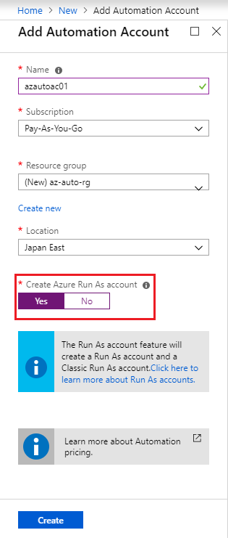
Automation accounts
To use Azure Automation you must create an Azure Automation account
Automation account acts as a container in which you store, manage and use automation artifacts
Provides a way to separate your environments or further organize your Automation workflows and resources.
Requires subscription-owner level access as provides access to all Azure resources via an API
Need at least 1 but should have multiple for access control
Run As account:
Can create when creating Azure Automation account
Creates a service principal user in Azure AD which allows access to Azure resources when running automation
Notes:
Could create Azure Automation accounts for dev, test, production, security, or other elements in your pipeline for more granular auditing, cost analysis and general management, as well as increased security.
When you create a Run As account, it creates a new service principal user in Azure Active Directory and assigns the Contributor role to this user at the subscription level

Slide 76
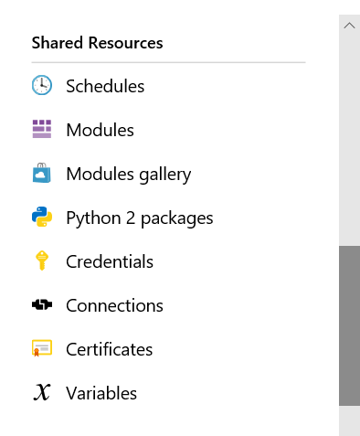
Automation shared resources
Azure Automation contains shared resources that are globally associated available to be used in, or with a runbook
Currently Eight Categories:
Schedules
Modules
Modules gallery
Python 2 packages.
Credentials
Connections
Certificates
Variables
Notes:
As a best practice, always try to create global assets so they can be used across your runbooks. This will save time and reduce the number of manual edits within individual runbooks.

Slide 77
What is a runbook?
A runbook is a set of tasks that perform some automated process in Azure Automation
Runbooks serve as repositories for your custom scripts and workflows
Can create your own or import and modify from community via Runbook Gallery
Runbook Types available:
Graphical runbook
PowerShell runbooks
PowerShell Workflow runbooks
Python runbooks
Notes:
They also typically reference Automation shared resources such as credentials, variables, connections, and certificates.
Runbooks can contain other runbooks, thereby allowing you to build more complex workflows. You can invoke and run runbooks either on demand, or according to a schedule by leveraging Automation Schedule assets
Could go to Runbook gallery and show students
https://gallery.technet.microsoft.com/scriptcenter/site/search?f[0].Type=RootCategory&f[0].Value=WindowsAzure&f[1].Type=SubCategory&f[1].Value=WindowsAzure_automation&f[1].Text=Automation

Slide 78
Automating processes with runbooks
Runbooks in Azure Automation can do anything that PowerShell can do because they are based on Windows PowerShell or Windows PowerShell Workflow and Python2
Example Usage Scenarios:
Automating resources in your on-premises datacentre
Start/Stop Azure virtual machines during off-hours solution in Azure Automation
Auto-stop VMs based on low CPU usage, to optimize VM costs
Send your Automation logs to LogAutomate provisioning of a virtual machine in Amazon Web Services (AWS)
Analytics for analysis and have alerts such as email configured to notify you of any failures or other relevant outcomes
Notes:
You can expand more on these scenarios if you wish using the below links
Start/Stop Azure virtual machines during off-hours solution in Azure Automation > https://docs.microsoft.com/en-us/azure/automation/automation-solution-vm-management
Autostop VMs based on low CPU usage, to optimize VM costs.
Automate provisioning of a virtual machine in Amazon Web Services (AWS) > https://docs.microsoft.com/en-us/azure/automation/automation-scenario-aws-deployment
Send your Automation logs to Log Analytics for analysis and have alerts such as email configured to notify you of any failures or other relevant outcomes. > https://docs.microsoft.com/en-us/azure/automation/automation-manage-send-joblogs-log-analytics#set-up-integration-with-log-analytics

Slide 79
Runbook gallery
Can import pre-existing runbooks from the runbook gallery at the Microsoft Script Center
Runbooks provided to help eliminate the time it takes to build custom solutions
Already been built by Microsoft and the Microsoft community
Can be used with or without modification
Can review the code or a visualization of the runbook code on the gallery as well as see source projects, rating etc.
Considerations:
Python runbooks are also available from the script center gallery. To find them, filter by language and select Python
You cannot use PowerShell to import directly from the Runbook Gallery
Notes:
Could go to Runbook gallery and show students the Microsoft Script Center at the URL below
https://gallery.technet.microsoft.com/scriptcenter/site/search?f[0].Type=RootCategory&f[0].Value=WindowsAzure&f[1].Type=SubCategory&f[1].Value=WindowsAzure_automation&f[1].Text=Automation

Slide 80
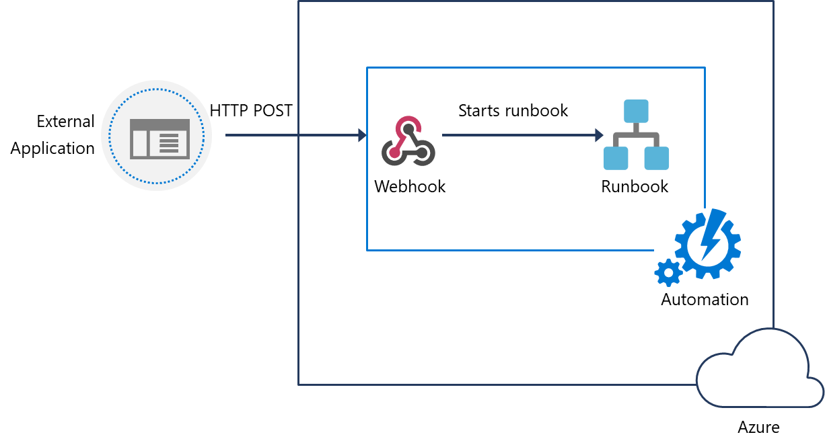
Webhooks
Automate the process of starting a runbook either by scheduling it, or by using a webhook.
Uses a HTTPS request to start a runbook
Reduces complexity and allows external services such as Azure DevOps, GitHub, or custom applications to use webhooks
Webhook Syntax: http://< Webhook Server >/token?=< Token Value >
Notes:
Note: When creating a WebHook make sure you make a copy of the webhook URL when creating it, and then store it in a safe place. After you create the webhook, you cannot retrieve the URL again. This is for security purposes
Also, when creating a webhook if the runbook has mandatory parameters, you will need to provide these mandatory parameters during webhook creation. You are not able to create the webhook unless values are provided.

Slide 81
Source control integration
Azure Automation supports source control integration
Azure Automation support the following source Control options:
Easier collaboration
GitHub
Increased auditing and traceability
Roll back to earlier versions of your runbooks
Azure DevOps (Git)
Can push code from Azure Automation to source control or pull your runbooks from source control to Azure Automation
Azure DevOps (TFVC)
Pull your runbooks from source control to Azure Automation
Notes:
Allows you to sync different branches in source control to your development, test, or production Azure Automation accounts.
Source control sync jobs run under the user's Automation Account and are billed at the same rate as other Automation jobs.

Slide 82
Update management
A service built-in to Azure Automation
Can be used to assess and manage operating system updates
Applicable to Windows or Linux environments in Azure, On-premises, or other clouds providers
Onboard machines in multiple Azure subscriptions in the same tenant
Components used:
Microsoft Monitoring Agent (MMA) for Windows or Operations Management Suite (OMS) Linux Agent
PowerShell DSC for Linux
Automation Hybrid Runbook Worker
Microsoft Update or Windows Server Update Services (WSUS) for computers running Windows operating systems or yum/apt/zypper package management services available on Linux

Slide 83
PowerShell workflows
Allows automation and orchestration of multi-environment tasks
Built on PowerShell and based on Windows Workflow Foundation
Characteristics:
Contain Activities – which are core a component of a workflow, are a specific task in a workflow
Tasks can be run in parallel
Can be long-running and repeated over and over (idempotent)
Be interrupted—can be stopped and restarted, suspended and resumed.
Continue after an unexpected interruption, such as a network outage or computer/server restart

Slide 84
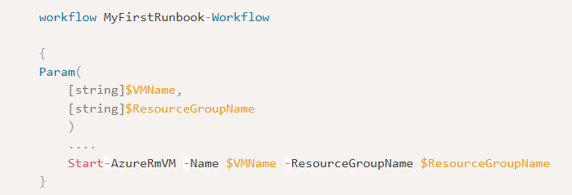
Creating a workflow
Can create with any script editor such as the Windows PowerShell Integrated Scripting Environment (ISE)
There are syntax differences between PowerShell scrips and Workflows
Requires keyword workflow to identify a workflow command
Add parameter values using keyword Param
Notes:
A benefit of using PowerShell ISE is that it automatically compiles your code and allows you to save the artifact. Because the syntactic differences between scripts and workflows are significant, a tool that knows both workflows and scripts will save you significant coding and testing time.

Slide 85
Checkpoint and parallel processing
Checkpoints:
If a workflow ends in an error or is suspended, the next time it runs it will start from its last checkpoint
You can set a checkpoint in a workflow with the Checkpoint-Workflow activity
A checkpoint is a snapshot of the current state of the workflow
Parallel Processing:
Use the Parallel keyword to create a script block with multiple commands that run concurrently
Tasks within this script block will be run concurrently or in parallel
Can use For Each with Parallel keyword for more granular control on parallelism
Notes:
Can talk through this example of Parallel task and run order.
Parallel
{
Start-AzureRmVM -Name $vm0 -ResourceGroupName $rg
Start-AzureRmVM -Name $vm1 -ResourceGroupName $rg
}
Start-AzureRmVM -Name $vm2 -ResourceGroupName $rg
vm0 and vm1 VMs will be started concurrently, and vm2 will only start after vm0 and vm1 have started.

Slide 86
Lesson 09: Additional automation tools

Slide 87

Azure SDKs
Install language SDKs for developing with Azure
Examples of available SDKs
.NET SDK
Java SDK
Node SDK
Python SDK
PHP SDK
Go SDK
For a complete list, see Azure Developer Tools (https://azure.microsoft.com/en-us/tools/)
Notes:
Don’t spend much time on this slide. It just provides some of the common SDKs available for developing on Azure. You can point students to https://azure.microsoft.com/en-us/tools/ for a more complete list of SDKS and developer tools.

Slide 88
Azure REST APIs
REST API request/response components:
Request URI
{URI-scheme} :// {URI-host}/{resource-path} ? {query-string}
HTTP request message header fields: GET, HEAD, PUT, POST, and PATCH
Optional additional header fields, for example an Authorization header that provides a bearer token to authorize a client request
HTTP response message header fields: HTTP status codes indicating success or error
Optional HTTP response message body fields: A MIME-encoded response return, such as a GET method returning data
Response objects typically returned as JSON or XML
Notes:
✔️ For additional details see the video How to call Azure REST APIs with Postman (https://docs.microsoft.com/en-us/rest/api/azure/#how-to-call-azure-rest-apis-with-postman).
This slides focuses on the syntax of the REST API request/response pair. The link to the video is a brief demonstration of how to call a REST API and it may be worth playing it for students.

Slide 89
Azure cloud shell
Cloud Shell hosted in the cloud and accessible via web browser and multiple access points including:
https://shell.azure.com
Directly via the Azure Portal,
Azure mobile app,
Visual Studio Code-Azure Account extension,
Authenticates automatically and securely with Azure
Can choose between Bash or PowerShell shell
Contains integrated script editor
Requires the creation of a storage account
Notes:
✔️ You might recommend the following video to students for viewing after class. It provides more details about Azure Cloud Shell. See Azure Friday – PowerShell in Azure Cloud Shell GA (https://azure.microsoft.com/en-us/resources/videos/azure-friday-powershell-in-azure-cloud-shell-ga/).

Slide 90
Package management
Package managers allow you to manage all aspects of software such as installation, configuration, upgrade, and uninstall
Various package management solutions are available depending on the environment:
apt: for Debian Linux
yum: for CentOS Linux
chocolatey: for Windows (built on PowerShell)
Many software packages, with multiple versions are available to install directly via package managers such as:
Visual studio
Git
Java and many more….
Notes:
Chocolatey does not have an msi, it installs as a nupkg using a PowerShell install script. You might want to walk through the script, which is found here (https://chocolatey.org/install.ps1).
If you have time and there is interest, you may want to look at some other installation options for this script at https://chocolatey.org/install#install-with-powershellexe.

Slide 91
Lab: Azure deployments using resource manager templates
In this lab, Azure Deployments using Resource Manager templates, we will customize an Azure Resource Manager template, by modularizing the resource definitions, then create a custom script extension as part of our template definition. Then we will deploy the defined resources into Azure and validate those resources have deployed successfully
Notes:
Lab Steps are available on GitHub at the below, under the Infrastructure as Code sections.
https://microsoft.github.io/PartsUnlimited
https://microsoft.github.io/PartsUnlimitedMRP

Slide 92
Thanks!

